Slide 1
Sitara Devices Overview
Embedded Processors Training
Multicore Applications
Literature Number: SPRPXXX

Slide 2
Agenda
Sitara Architecture
Processors
Peripherals
Buses and Memory
Tool and Software
Development Tools
Linux SDK
Development Platforms

Slide 3
Sitara Architecture: Processors
Sitara Devices Overview

Slide 4
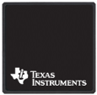

Hero Processors Available Today
AM335x
AM437x
OMAP
L138
C667x
C665x
Core
Cortex™-A8 up to 1GHz
Cortex®-A9 up to 1GHz
ARM9 ≤ 456 MHz
C674x DSP ≤456Mhz
1 - 8 C66x DSP ≤1.25Ghz
DMIPS
MFLOPS
Up to 2000 DMIPS
Up to 2500 DMIPS
Up to 410 DMIPS
Up to 2746 MFLOPS
Up to 160GFLOPS
Graphics
SGX530
SGX530
N/A
N/A
Memory
LPDDR1/DDR2/DDR3
LPDDR2/DDR3(L)
LPDDR1/DDR2
DDR3 @ 1333
OS
Linux/Android/ StarterWare/RTOS
Linux/RTOS
BIOS / Linux Multicore SDK
BIOS /Linux Multicore SDK
LCD Controller, CAN, Gb EMAC switch, 2x USB w/PHY, Industrial Protocols, Touch Screen Control
Display Subsystem, Dual camera, Quad core PRU-ICSS, QSPI, Gb EMAC switch, 2x USB w/PHY
LCD Controller, SATA, Video In/Out, 10/100 EMAC, USB w/PHY, PRU
SRIO, 2x PCIe Gen 2,
1Gbps Ethernet, uPP, UART, I2C up to 8MB SRAM
Key
Features
Apps
PND, Connected Home, Industrial Automation
Industrial automation and drive, PDT, scanners
Machine Vision, Power
Protection, PMR
Machine Vision, Imaging, Video Analytics
Pricing
Starting at $7.20 (10Ku)
Starting at $10.60 (10K)
Starting at $12.78 (10K)
$27.25 – $66.70 (10K) (C665x)
$132 - $197 (10K) (C667x)
Notes:
“Hero” processors are the most popular devices available from the portfolio. They have all been recently released, have the most up-to-date collateral and software and have the best available support.

Slide 5
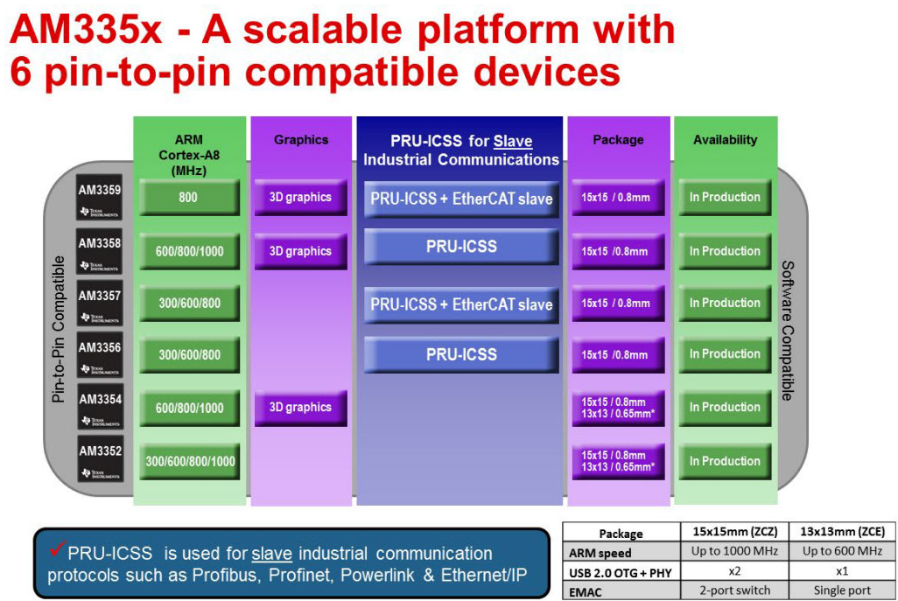

Slide 6




AM437x: A Scalable Platform with 4 pin-to-pin Compatible Devices
ARM Cortex-A9
(MHz)
Graphics
Programmable Real-time Unit & Industrial Communication Sub-System (PRU-ICSS)∆
Package
AM4379
800/1000*
3D graphics
PRU-ICSS + EtherCAT® slave
17x17/0.65mm †
Pin-to-Pin Compatible
Software Compatible
AM4378
800/1000*
3D graphics
PRU-ICSS
17x17/0.65mm †
AM4377
800/1000*
PRU-ICSS + EtherCAT® slave
17x17/0.65mm †
AM4376
800/1000*
PRU-ICSS
17x17/0.65mm †
∆ PRU-ICSS is commonly used for slave industrial communication protocols such as PROFIBUS, PROFINET®, Powerlink, Ethernet/IP™ and EnDat
† Via Channel Array technology provides 0.8mm-pitch effective layout routing rules.
*pending silicon characterization

Slide 7
Sitara Applications
Patient Monitoring
Security Applications
Bar Code Scanners
Navigation Equipment
Point of Service
Industrial Automation
Portable Mobile Radio
Portable Data Terminals
Test And Measure
Notes:
EPOS - Electronic point of sale
SK – Software Kit
IDK – Industrial Development Kit
HS- High Security

Slide 8
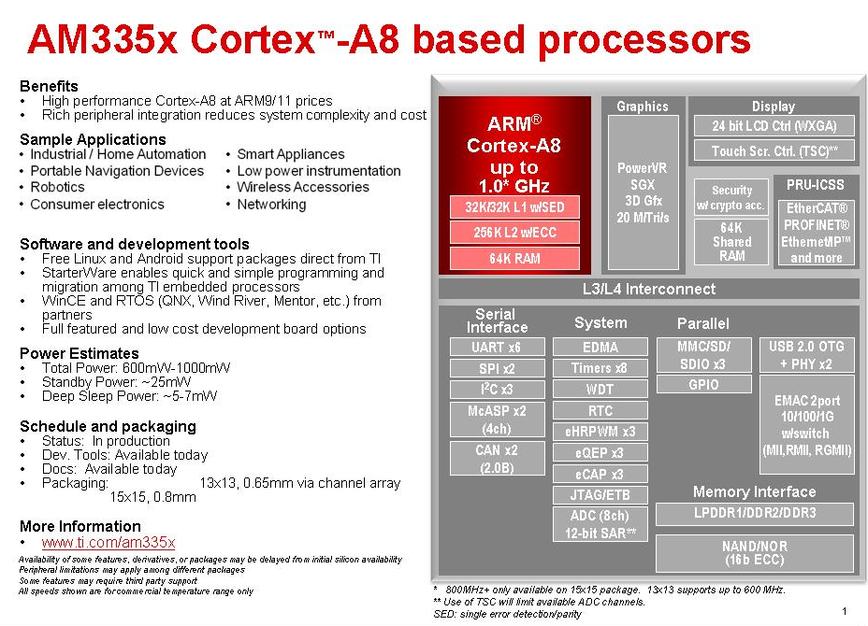

Slide 9

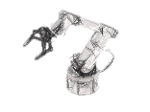


AM437x Cortex™A9-based Processors
Benefits
Performance
High performance Cortex-A9 up to 1GHz
display system
Security Engine
PRU-ICSS
Multiple system services
Peripherals and Connectivity
Variety of peripherals
Multiple high bit rate interfaces for data IO
Multiple interfaces for boot and control/monitor
Power Targets
Total Power: <1000mW
Deep sleep: ~4mW
RTC-only mode: <0.03mW
Software and development tools
Free Linux SDK directly from TI
RTOS (QNX, Nucleus, Green Hills, etc) from partners
Full featured and low cost development board options (EVM, SK, IDK)
Schedule and packaging
Samples and Dev. Tools: 2Q 2014
Production: 4Q 2014
Package: 17x17mm, 0.65 VCA, 0.8mm-pitch effective routing
ARM®
Cortex A9
Up to 1 GHz
Graphics Acceleration
SGX530
PRU
Industrial
Communication Subsystem EtherCAT®,PROFINET®, EtherNET/IP™ + Motor Feedback
Protocols +
Sigma Delta
32K/32K L1
Display
Subsystem
256K L2 / L3
64K RAM
24bit LCD
Touch Screen Controller⁽¹⁾
Security AccelerationPac
Crypto, Secure boot
Processing
Overlay, Resizing, Color Space Conversion, etc.
256KB L3 Shared RAM
32-bit LPDDR2/DDR3/DDR3L⁽²⁾
System Services
Simple Pwr Seq
EDMA
Debug
12 Timers
SyncTimer32K
WDT
RTC
2 12-bit ADCs⁽¹⁾
Connectivity and IOs
EMAC
2-port switch 10/100/1G w/1588
Camera I/F (2x Parallel)
CAN x2
PWM x6
McASP x2
NAND
/NOR (16bit ECC)
eCAP/
eQEP x3
SPI x5
GPIO
USB2 OTG +PHY x2
3 MMC/ SD/SDIO
QSPI
HDQ
I2C x3
UART x6

Slide 10
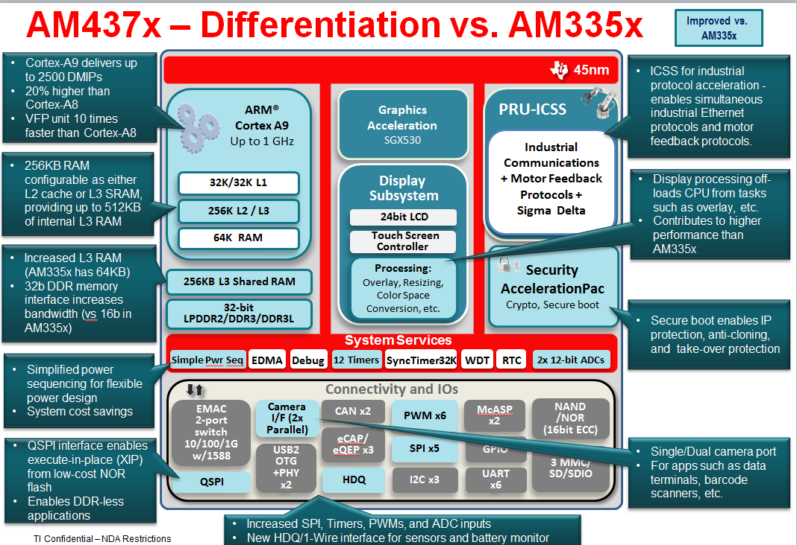

Slide 11
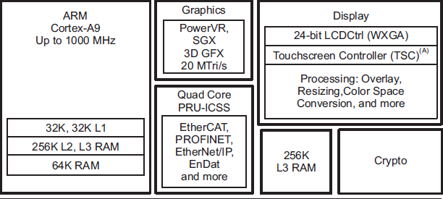
AM437x Architecture: Processors and Co-processors
Notes:
SGX530 – graphics Accelerator - features pixel, vertex, and geometry shader hardware, supporting OpenGL ES - 7M Triangles and 200M Pixels 1.6GFLOPS
OpenGL for Embedded Systems (OpenGL ES or GLES) is a subset of the OpenGL computer graphics rendering application programming interface (API) for rendering 2D and 3D computer graphics such as those used by video games, typically hardware-accelerated using a graphics processing unit (GPU).
Crypto

Slide 12
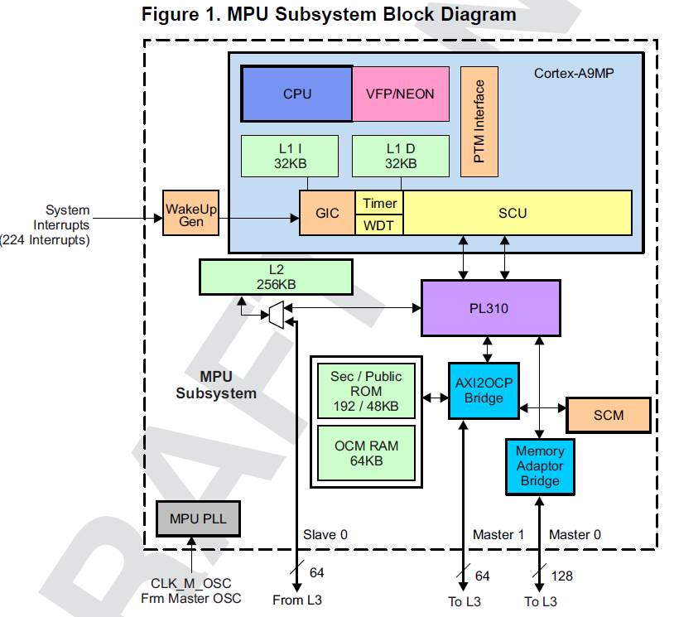
Cortex-A9 (AM437x) vs Cortex-A8 (AM335x)
VFP Fully Pipelined ~10x floating point speed up
Out of order processing and other performance improvements giving 2.5 DMIPS/MHz (2.0 for AM335)
External PL310 cache controller
L2 Cache can be used as generic SRAM (SRAM or Cache - no mixing)
Interrupts (more interrupts, 224)
Generic Interrupt Controller
Wakeup Gen
Local counter, watchdog timer
Up to 1GHz MPU clock

Slide 13
Cortex-A9 Features
Superscalar architecture:
8 functional units-2 ALU, 2 shifts, branch unit, multiply and divide, load store
2 concurrent decoded
Full implementation of ARMv7-A architecture instruction set:
More MAC instructions (normalization and rounding)
Integer divide
Pipeline optimization:
Speculating dynamic pipeline, 8-11 stages to issue
Out-of-order pipeline (8-11 stages) execution
Notes:
8 issues:
2 for Neon- VFP
2 for load and store
4 for the other (ALU, Shift, multiply)

Slide 14
Cortex-A9 Features
Dynamic branch prediction – Loop prediction and indirect branch predictor
Branch Target Address Cache (BTAC)
Global History Buffer (GHB) has three arrays:
Taken array
Not taken array
Selector array
Return Stack

Slide 15
SIMD Engine NEON
64/128-bit data instructions
Fully integrated into the main pipeline
32x 64-bit registers that can be arranged as 128-bit registers
Data can be interpreted as follows:
Byte
Half-word (16-bit)
Word
Long

Slide 16
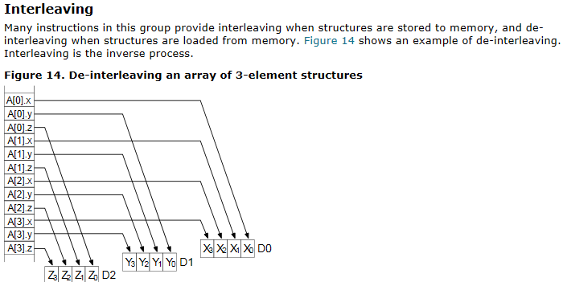
NEON Registers
NEON registers load and store data into 64-bit registers from memory with on-the-fly interleave, as shown in this diagram.
Source: ARM Compiler Toolchain Assembler Reference; DUI0489C

Slide 17
Vector Floating Point (VFP)
Fully integrated into the main pipeline
32 DP registers for FP operations
Native (hardware) support for all IEEE-defined floating-point operations and rounding modes; Single- and double-precision
Supports fused MAC operation (e.g., rounding after the addition or after the multiplication)
Supports half-precision (IEEE754-2008); 1-bit sign, 5-bit exponent, 10-bit mantissa

Slide 18
Programmable Real-Time Unit (PRU) Subsystem
User Guide: http://processors.wiki.ti.com/index.php/PRU-ICSS
Programmable Real-Time Unit (PRU) is a low-latency microcontroller subsystem
Two independent PRU execution units:
32-Bit RISC architecture
200MHz; 5ns per instruction
Single-cycle execution; No pipeline
Dedicated instruction and data RAM per core
Shared RAM
Interrupt Controller (INTC) for system event handling
Fast I/O interface provides up to 30 inputs and 32 outputs on external pins per PRU unit.
AM335x PRU Subsystem Block Diagram
Industrial Ethernet
MII0 RX/TX
DRAM0
(8K Bytes)
32 GPO
PRU0 Core
(8KB IRAM)
30 GPI
DRAM1
(8K Bytes)
Scratch Pad
Shared
(12K Bytes)
32 GPO
PRU1 Core
(8KB IRAM)
32-bit Interconnect bus
30 GPI
Master I/F (to SoC interconnect)
Industrial Ethernet
MII1 RX/TX
Slave I/F (from SoC interconnect)
MDIO
IEP (Timer)
UART
Events to ARM INTC
eCAP
Interrupt Controller (INTC)
Events from Peripherals + PRUs
MPY/MAC
Notes:
Notes:
AM335x:
- 8K Byte instruction RAM (2K instructions) per core
- 8K Bytes data RAM per core
- 12K Bytes shared RAM
Although PRU can only run from IRAM, it can be reset and new code can be loaded. This allows you to use the PRU for multiple functions.
Each PRU has a total of 32 output pins and 30 input pins. Pins are multiplexed with other peripherals at the system level so there are pin muxing considerations to be kept in mind.
Main point:
The PRU subsystem has key features and dedicated resources that help solve real-time problems.
Key features:
2 PRU cores – each with dedicated instruction RAM
- RISC processors
IEP (timer) –
eCap – PWM (Pulse width Modulation) Enhanced Capture Module – input or output
instruction fetch: grab the instruction located at address pc instruction
decode: parse the instruction. what is the opcode, what registers do we need, what is value of the immediate, etc read registers:
grab whatever register values we need from the register file execute: we now have all the data we need to execute the instruction,
so execute the instruction. if it's an add instruction, add the register values, etc.
write register: write a new register value into the register file, if necessary [not necessary for stores]

Slide 19
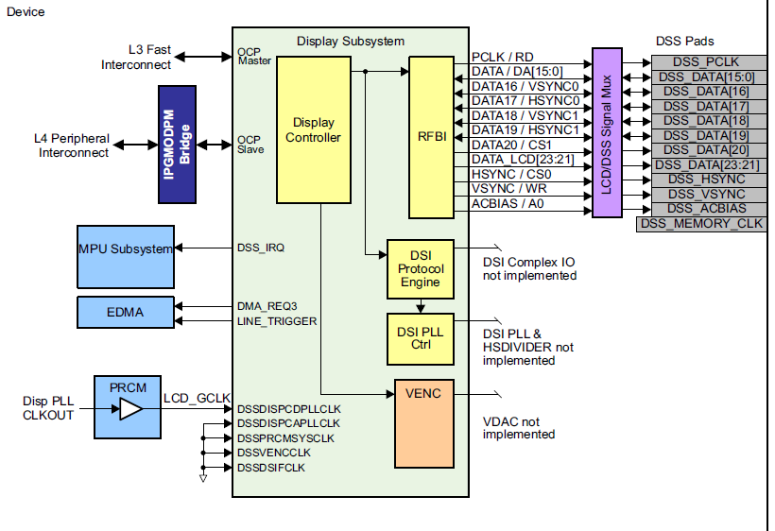
Display Subsystem (DSS)
Getting input data from frame buffer, sending output image or video to external display.
Notes:
VENC -

Slide 20
Display Subsystem (DSS)
Display Subsystem:
Up to 100MHz pixel clock
Up to 2048x2048 resolution, highly dependent on frame rate, bpp, etc.
Display Controller:
Input modes:
Programmable pixel display modes (1, 2, 4, 8, 12, 16, 18 and 24 bit-per-pixel modes, YUV and 24 bits RGB)
256 x 24-bit entry palette in RGB
Display support:
Passive & Active Matrix panel.
Remote Frame Buffer support through the RFBI module.
Signal processing:
Overlay support for Graphics,Video1 and Video2
Video resizer : upsampling (up to x8) downsampling (down to 1/4)
Transparency color key (source and destination)
Programmable video color space conversion YcbCr 4:2:2 into RGB
Gamma curve support
Programmable Color Phase Rotation (CPR)
Notes:
VENC - Composite Video, S-Video
Passive active Matrix Panel – supply the voltage to the LCD
Transparency color key - mixing multiple colors
Gamma curve support - compensate for the way the eye sees things
Programmable Color Phase Rotation – changing the phase of presentation of color (2 values, radius and phase)

Slide 21
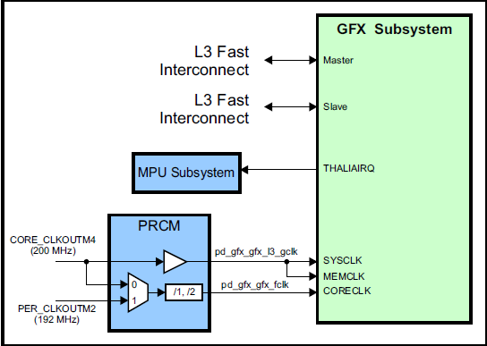
Graphic Accelerator SGX530 (Imagination Technologies)
2D and 3D graphics
Tile-based architecture
Universal Scalable Shader Engine (USSE™): multithreaded engine incorporating pixel and vertex shader functionality
Industry-standard API support: OpenGL ES 1.1 and 2.0, OpenVG v1.0.1
Advanced geometry direct memory access (DMA)
Programmable high-quality image anti-aliasing

Slide 22
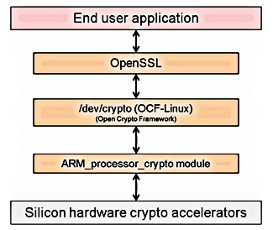
Crypto Hardware Accelerator
Offloads cryptographic processing from the ARM core
OpenSSL
Crypto
Secure Boot
Notes:
OpenSSL is an open-source implementation of the SSL and TLS protocols.
The core library, written in the C programming language, implements basic cryptographic functions and provides various utility functions.

Slide 23
Sitara Architecture: Peripherals
Sitara Devices Overview

Slide 24
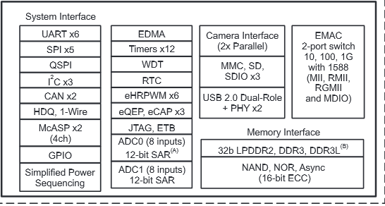
AM437x Architecture: Peripherals

Slide 25
Camera Subsystem (2x)
Dual-port, 8/10-bit BT656 interface
Single-port, 12-bit interface
YUV422/RGB422, BT656, RAW input formats
Up to 75MHz input pixel clock
Parallel camera
Camera clock
and
synchronization signal
Timing control
VPFE
processing sub module
C C D C
PREVIEW
L3
MMU
REGISTERS
L4
Notes:
VPFE – Video Port Front End
BT 656 – digital video Protocol for streaming uncompressed PAL or NTSC
CCD – Charged Couple device (digital camera)
CCDC – Charge Couple device controller
75MHZ input pixel clock (2Kx1Kx30fps)

Slide 26
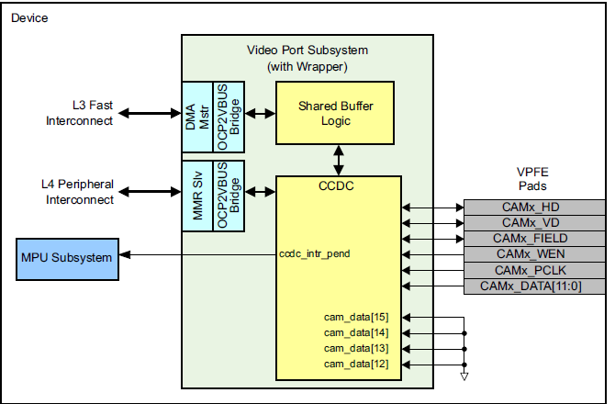
Camera Subsystem
Notes:
VPFE – Video Port Front End
BT 656 – digital video Protocol for streaming uncompressed PAL or NTSC
CCD – Charged Couple device (digital camera)
CCDC – Charge Couple device controller
For 16 bits interface, two VPFE are connected together
Row data - color filter array (CFA or RGB color space Foveon X3 sensors

Slide 27
EMAC: Ethernet Media Access Controller
AM437x
AM437x
Port2
Port2
Port0
Port1
Port0
Port1
Dual MAC mode
Switch mode
Two 10/100/1000Mb external ports, 3-port Ethernet switch
Supports standard Media Independent Interface (MII), Reduced Media Independent Interface (RMII), Gig Reduced Media Independent Interface (RGMII) to physical layer device (PHY)
Layer 2 switch (1024 addresses LUT)
Includes MDIO interface to control/communicate with PHY
Reset Isolation
EXTDEV PLL to provide clock to external PHY
Notes:
(Ipv4, Ipv6, 802.3x) - software support
MDIO – Management Data Input-Output serial link to talk to the physical front end

Slide 28
Ethernet: Changes from AM335x
Added capability to derive REFCLK for Ethernet PHY from AM437x
Added Low Jitter EXTDEV PLL
Saves cost of external crystal or oscillator for PHY
25MHz REFCLK for other PHYs
50MHz REFCLK for RMII PHY clock (default for ROM for boot)
Separated voltage domains of MDIO clk/data and Ethernet I/F in all I/O sets
Compliant to IEEE Ethernet Vmin=2.0V spec
Expanded pinmux options
NAND + Dual Ethernet supported
IEEE1588 TimeStamp
Provides accurate time based control over Ethernet
Ability to provide separate PLL (reusing Display PLL) with Fractional M multiplier for time stamping
IPV6 time stamping. Now supporting Annex D, E , F
Added support for Ethernet operation in CORE OPP50
Internal TX Delay mode supported by default to enable RGMII boot
AM437x
Ethernet
PHY
CLKOUTx

Slide 29
Universal Serial Bus (USB 2.0)
Benefit: 2x xHCI DRD (dual-role device) USB controllers with embedded DMA and integrated PHYs provide a mechanism that complies with the USB2.0 standard for data transfer between USB devices up to 480 Mbps. Its dual-role feature allows the capability to operate as a host or peripheral.
20+% performance improvement
AM335x
Mentor OTG controller
AM437x
xHCI controller
New generation xHCI provides industry standard register definition for USB host controllers supported by open-source drivers
AM437x adds capabilities to xHCI for peripheral mode
2 ports (USB0 and USB1)
Both ports bootable
USB0 as peripheral.
USB1 as host. Can boot off of a MSD (i.e., flash drive)
Notes:
eXtensible Host Controller Interface (xHCI) is a computer interface specification
DM/DP differential physical interface, data plus data minus
Super Speed – 5G not supported
Internal DMA controller
– Descriptor caching and data pre-fetching ensures high performance
– Dynamic FIFO memory allocation for all endpoints
OCP – open Core Protocol

Slide 30
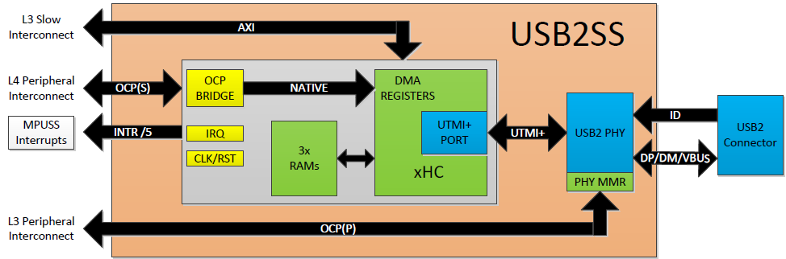
Universal Serial Bus (USB 2.0)
Operating as a host, it complies with the USB2.0 standard for high-speed, full-speed and low-speed operation with a peripheral.
Operating as a peripheral, it complies with the USB2.0 standard for high-speed and full-speed operation with a host.
SuperSpeed is not supported! (Did not integrate SuperSpeed PHY)
Supports all modes of transfers (control, bulk, interrupt, and isochronous)
Supports 15 simultaneous Transmit (TX) and 15 Receive (RX) endpoints, in addition to endpoint 0
All new devices (Keystone, Vayu, etc.) going forward will be using xHCI controller (driver compatibility).
Notes:
eXtensible Host Controller Interface (xHCI) is a computer interface specification
DM/DP differential physical interface, data plus data minus
Super Speed – 5G not supported
Internal DMA controller
– Descriptor caching and data pre-fetching ensures high performance
– Dynamic FIFO memory allocation for all endpoints
OCP – open Core Protocol )additional P – Presence - assertions and constraints
UTMI, USB 2.0 Transceiver Macrocell Interface

Slide 31
External Memory Interfaces
Features of the GPMC include:
8-bit and 16-bit wide data bus
Programmable cycle timings for each chip select
Up to 16-bit ECC support for NAND Flash using BCH code (t=4, 8 or 16) or Hamming code for 8-bit or 16-bit NAND-flash
Integrated ELM (Error Locator Module) to provide ECC calculation (up to 16b) for NAND support. Supports 4-bit, 8-bit and 16-bit per 512byte block error location based on BCH algorithms
used to connect NAND, NOR (async and sync), FPGAs, etc
Features of the MMC/SD include support for:
3 MMC/SD ports
Multimedia card (MMC v4.3/ SD 2.0 ), supports >2GB capacity on eMMC boot on MMC0
Card detect and write protect on each MMCSD port
48 MHz maximum I/O clock rate (up to SDR25 speeds)
Features of the QSPI include:
Supports up to 4bit read, 1bit write
Up to 48MHz clock, Master only
Supports eXecute-In-Place (XIP) from serial NOR flash
Primarily intended for fast boot from quad-SPI flash devices
New feature vs. AM335x

Slide 32
AM437x: Numerous Serial Peripherals
12 GP Timers & 1 watchdog timer
Free-running 32-bit upward counter. Runs off 32KHz or 19.2, 24, 25, 26 MHz system clock.
WDT: MPU Watchdog (runs off of 32KHz system clock)
1 Sync Timer (32KHz)
Special always on 32K timer for OS
I2C (3)
3 I2C ports compliant with Philips I2C specification version 2.1
Support for standard (up to 100K bits/s) and fast (up to 400K bits/s) modes
General-Purpose I/O (GPIO) Interface (6 banks)
Synchronous interrupt requests in active mode from each channel are processed by GIC (General Interrupt Controller) in MPUSS.
Asynchronous wake-up request
192 total GPIOs muxed with other signals
Multichannel Audio Serial Port Interface (2)
Data Clock 50 MHz ,
Two Clock Zones and up to 4 Serial Data Pins per McASP port
Supports TDM, I2S and Similar Formats
Supports DIT mode
Universal Asynchronous Receiver Transmitters (UART) (6)
UART1 will support full Modem Control (CTS,RTS,DTR, DSR, DCD, RIN)
All UARTs support IrDA, CIR and RTS, CTS flow control.
Supports baud rate up-to 3.6M bits/s.
New feature vs. AM335x

Slide 33
AM437x: Numerous Serial Peripherals
PWM Subsystem
eCAP (3)
Up to Three 32-bit enhanced Capture Modules – configurable as 3 capture inputs or 3 auxiliary PWM outputs
eHRPWM (6)
Up to Six Enhanced High Resolution PWM modules (eHRPWM) – with dedicated 16-bit time base counter with time and frequency controls.
eQEP (3)
Up to Three 32-bit enhanced Quadrature Pulse Encoder modules
HDQ/1-wire
For connection to battery gauges
DCAN (2)
Same as AM335x
McSPI
Master/Slave operation, 48MHz clock
Up to 4 channels for each McSPI0,1, two channels on McSPI2,3
New feature vs. AM335x

Slide 34
AM437x: Two ADCs
AM437x
AM335x
ADC0
ADC0 (Touchscreen)
12-bit Successive Approximation Register (SAR) ADC
867KSPS
8 analog inputs
Can be configured as a Touchscreen Controller. When configured as TSC, it takes away pins/channels for general purpose ADC use.
ADC1
12-bit Successive Approximation Register (SAR) ADC with preamp
867KSPS
8 analog inputs
ADC0
ADC1
ADC0
8 inputs
AFE
Simultaneous mode:
ADC1 controls ADC0 AFE
2x 16-bit results can be read from one 32-bit register inputs converted to 32-bit value
ADC1
16bits
FIFO1
32bits
8 inputs
AFE
FIFO0
16bits
New feature vs. AM335x

Slide 35
Sitara Architecture: Buses & Memory
Sitara Devices Overview

Slide 36
Sitara Architecture: Memory and Buses
L3 Interconnect
ARM Subsystem
Programmable Real-Time Unit (PRU) Subsystem
Interconnect
PRU0 (200MHz)
PRU1 (200MHz)
PRU0 I/O
Cortex-A8
L3 Interconnect
PRU1 I/O
Shared RAM
Inst. RAM
DataRAM
Inst. RAM
DataRAM
L1 Instruction Cache
L1 Data Cache
L2 Data Cache
L4 Interconnect
INTC
Peripherals
Shared
Memory
Peripherals
Peripherals
GP I/O
Notes:
ARM + PRU + memories + peripherals = SoC
PRU works as a co-processor in system-level implementation, or
- PRU works independently

Slide 37
Sitara Memory
MPU Internal memories
32K L1P, 32K L1D, 256K L2/L3, 64K RAM
PRU Internal memory
Data and Instruction RAM per PRU, Shared RAM
L3 Shared RAM (OCMC)
256KB shared memory (64K AM335)
External Memory
32-bit LPDDR2/DDR3/DDR3L (16-bits AM335X)
New feature vs. AM335x
Notes:
PMU – Programming Multi-channel Unit (The ARM module)
LPDDR - Low Power Double Data Rate memory 266MHZ
DDR3 – 400MHZ
DDR3L – low voltage DDR3
OCMC – On chip memory controller

Slide 38
AM437x Memory Interface (LPDDR2/DDR3)
Features of the EMIF4D include:
Frequency Targets
LPDDR2: 266 MHz Clock (532 MHz Data Rate)
DDR3 (1.5V) /DDR3L (1.35V): 400 MHz Clock (800 MHz Data Rate)
No support for mDDR or DDR2
16- or 32- bit data bus
2GB total addressable space
Supported memory configurations:
1 load (x32 device)
2 loads (x16 devices)
4 loads (x8 devices)
Supports a maximum of 4 address loads DDR3, 2 data loads for LPDDR2, and 1 data load for DDR3
New feature vs. AM335x
T topology
DDR3
(x16)
AM437x
DDR3
(x16)
Fly-by topology
Point-to-point
D[31:16]
AM437x
LPDDR2 (x32)
AM437x
D[15:0]
DDR3
(x16)
DDR3
(x16)
AM437x
DDR3
(x16)
Addr/Ctrl
VTT

Slide 39
AM437x DDR3 Low Power
New feature vs. AM335x
DeepSleep
AM437x
VDDS_DDR
DDR3
VDDS_DDR
DDR_RESET
Low-power enhancements for DDR3:
Fail Safe I/O for DDR_RESET: Facilitates external pull-up to keep DDR in self-refresh during RTC+DDR.
PMIC: Load Switch facilitates separation of DDR voltage to AM437x and DDR memory
Added extra signaling in hardware to facilitate suspend/resume sequencing
DDR_CKE
WKUP
RTC + DDR
VDDS_DDR
AM437x
VDDS_DDR
DDR3
DDR_RESET
DDR_CKE

Slide 40
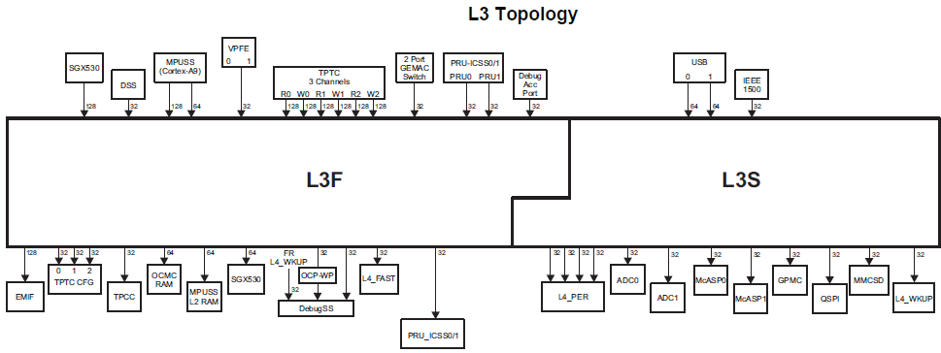
Buses and Memory: Inter-Connect
L3 high-performance interconnect:
Packet based protocol based on a Network-On-Chip (NoC) interconnect infrastructure
Connect all high-bit rate peripherals and IP

Slide 41
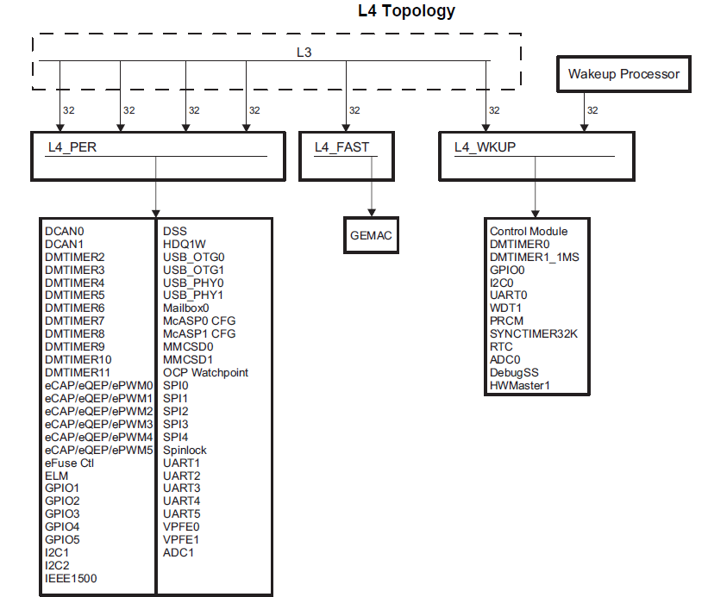
Buses and Memory: Inter-Connect
L4 low-latency, low-bandwidth access inter-connect:
Non-blocking peripheral interconnect
Up to 4 masters (Initiators) and up to 63 slaves (targets)

Slide 42
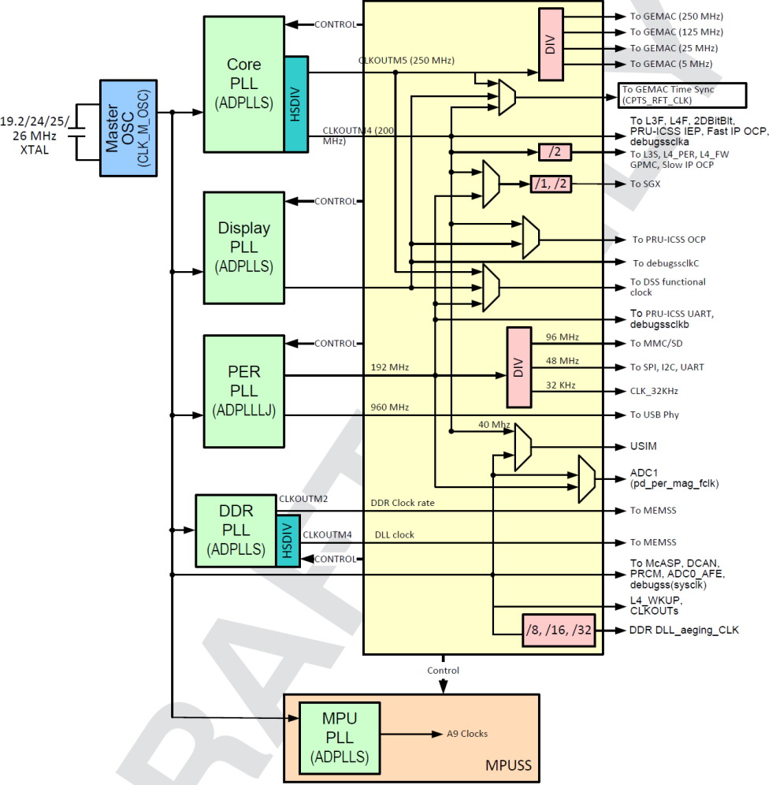
Clocks
New feature vs. AM335x
Input clocks to device:
19.2, 24, 25, 26 MHz system clock
32kHz RTC clock from crystal or PER PLL
6 PLLs to generate various system clocks:
MPU PLL: ARM MPU subsystem
DDR PLL for DDR interface
PER low-jitter PLL: USB & peripherals (MMC/SD, UART, SPI, I2C, etc.)
CORE PLL: L3, L4, Ethernet, SGX
Display PLL: DSS Pixel Clock and IEEE1588
EXT low-jitter PLL drives external devices through CLKOUTx

Slide 43
System Enhancements over AM335x
I/O Cell Power Management:
I/O daisy chaining allows for wakeup from any GPIO, not just wakeup domain GPIO0
I/O Isolation provides more control with low-power pad configuration
MPU Auto Clock Gating:
MPU will automatically be clock gated in WFI
Wakeup via interrupts
Simplified Power Sequencing:
Provide 1.8V bias voltage from 3.3V rail.
Simplifies power up/down sequencing for discrete power solutions
New feature vs. AM335x

Slide 44
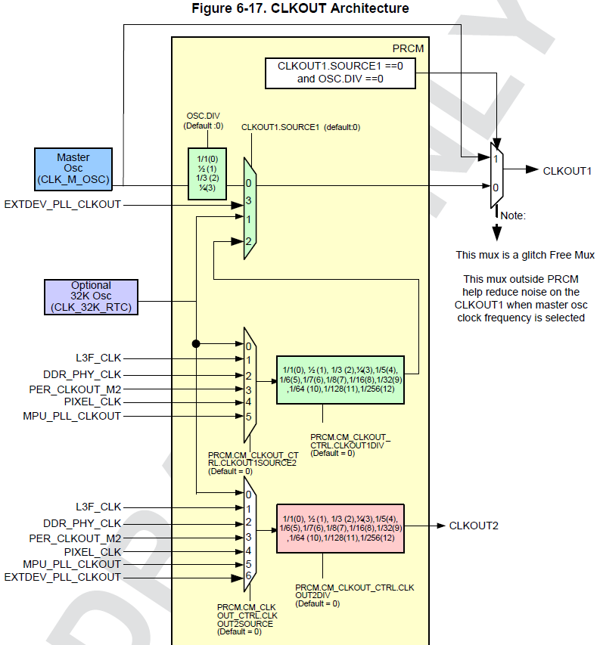
System Enhancements over AM335x
Improved CLKOUT performance:
Output buffers are on separate voltage domain to reduce noise
Provided low jitter PLL for Ethernet, modem applications
Added different input options (MPU clock, EXT PLL)
CLKOUT1 path is optimized
New feature vs. AM335x

Slide 45
AM437x ROM
New feature vs. AM335x
Boot from a number of sources, selectable with SYSBOOT pins:
Memory boot
SD cards
eMMC support for >2GB on either MMC0 or MMC1
NOR flash support for muxed and non-muxed XIP boot
NAND flash 8- or 16-bit
SPI EEPROMs
QSPI: XIP boot from serial flash
USB Host (USB1): USB mass storage devices, USB thumb drives, great for product upgrades
Peripheral boot:
Ethernet support for MII, RMII, and RGMII boot.
USB client (USB0)
UART
Other SYSBOOT selectable features:
USB data polarity
Some pinmux options on certain interfaces (QSPI, NAND)
Input frequency (19.2, 24, 25, 26MHz)
Enable CLKOUT1
Boot occurs in MPU and CORE OPP50 in all modes

Slide 46
AM437x Differentiation vs. AM335x
Improved vs.
AM335x
Cortex-A9 delivers up to 2500 DMIPs
20% higher than Cortex-A8
VFP unit 10 times faster than Cortex-A8
45nm
ICSS for industrial protocol acceleration - enables simultaneous industrial Ethernet protocols and motor feedback protocols.
ARM®
Cortex A9
Up to 1 GHz
Graphics Acceleration
SGX530
PRU-ICSS
Industrial
Communications + Motor Feedback
Protocols +
Sigma Delta
256KB RAM configurable as either L2 cache or L3 SRAM, providing up to 512KB of internal L3 RAM
32K/32K L1
Display
Subsystem
Display processing off-loads CPU from tasks such as overlay, etc.
Contributes to higher performance than AM335x
256K L2 / L3
24bit LCD
64K RAM
Touch Screen Controller
Increased L3 RAM (AM335x has 64KB)
32b DDR memory interface increases bandwidth (vs 16b in AM335x)
Security AccelerationPac
Crypto, Secure boot
Processing:
Overlay, Resizing, Color Space Conversion, etc.
256KB L3 Shared RAM
32-bit LPDDR2/DDR3/DDR3L
Secure boot enables IP protection, anti-cloning, and take-over protection
System Services
Simplified power sequencing for flexible power design
System cost savings
Simple Pwr Seq
EDMA
Debug
12 Timers
SyncTimer32K
WDT
RTC
2x 12-bit ADCs
Connectivity and IOs
EMAC
2-port switch 10/100/1G w/1588
Camera I/F (2x Parallel)
CAN x2
PWM x6
McASP x2
NAND
/NOR (16bit ECC)
QSPI interface enables execute-in-place (XIP) from low-cost NOR flash
Enables DDR-less applications
eCAP/
eQEP x3
SPI x5
GPIO
Single/Dual camera port
For apps such as data terminals, barcode scanners, etc.
USB2 OTG +PHY x2
3 MMC/ SD/SDIO
QSPI
HDQ
I2C x3
UART x6
Increased SPI, Timers, PWMs, and ADC inputs
New HDQ/1-Wire interface for sensors and battery monitor

Slide 47
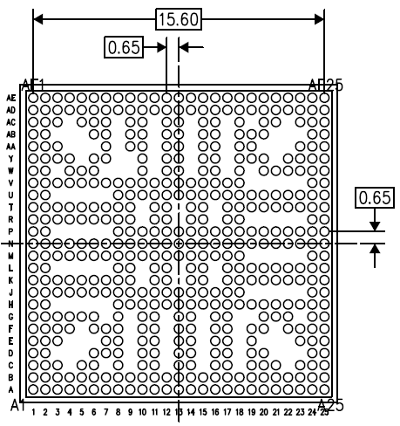
Package
ZDN Package:
17x17 mm 0.65 pitch via channel array [0.8 routable] package
Separate VDD_MPU and VDD_CORE

Slide 48
Tools and Software: Development Tools
Sitara Device Overview

Slide 49
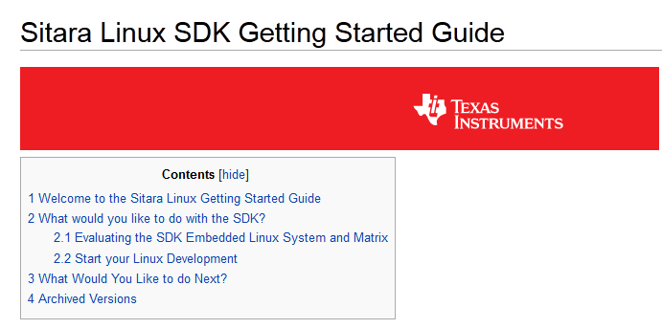
Getting Started Guide http://processors.wiki.ti.com/index.php/Sitara_Linux_SDK_Getting_Started_Guide

Slide 50
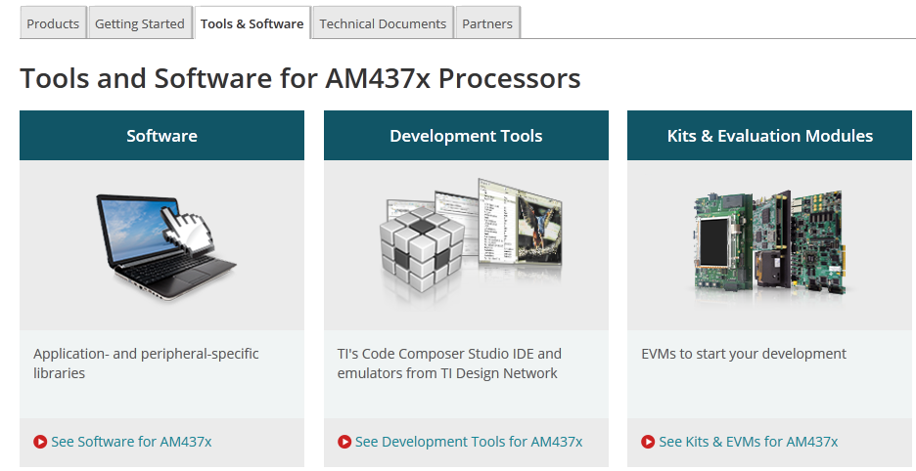
Software and Tools Page http://www.ti.com/lsds/ti/arm/sitara_arm_cortex_a_processor/arm_cortex_a9_core/am437x_arm_cortex_a9/tools_software.page

Slide 51
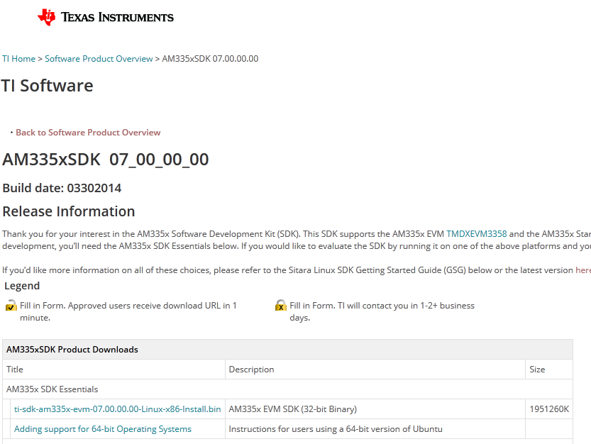
Software Product Page http://software-dl.ti.com/sitara_linux/esd/AM335xSDK/latest/index_FDS.html

Slide 52
Software Product Page http://software-dl.ti.com/sitara_linux/esd/AM335xSDK/latest/index_FDS.html

Slide 53
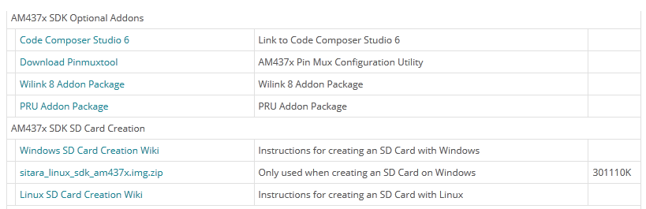
Software Product Page http://software-dl.ti.com/sitara_linux/esd/AM335xSDK/latest/index_FDS.html

Slide 54
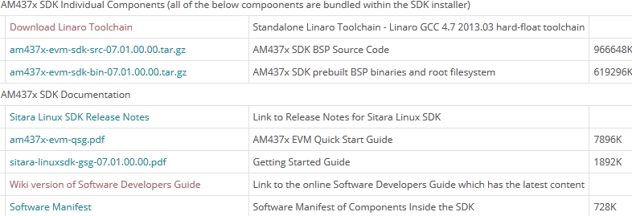
Software Product Page http://software-dl.ti.com/sitara_linux/esd/AM335xSDK/latest/index_FDS.html

Slide 55
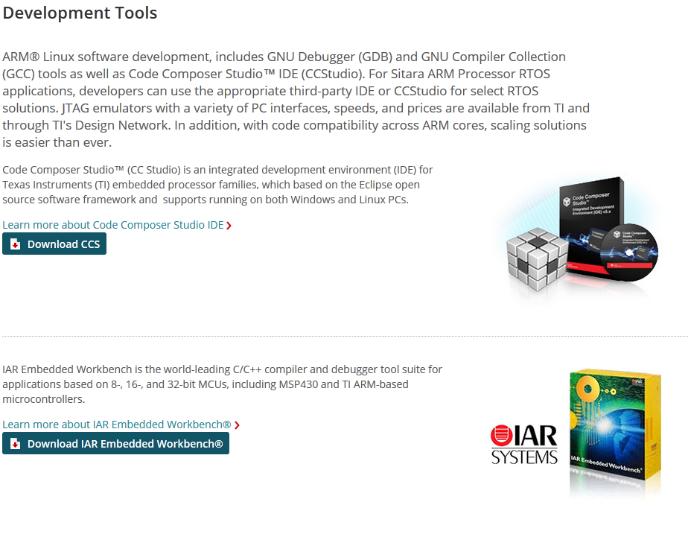
Development Tools http://www.ti.com/lsds/ti/arm/sitara_arm_cortex_a_processor/arm_cortex_a9_core/am437x_arm_cortex_a9/tools_software.page#tools

Slide 56
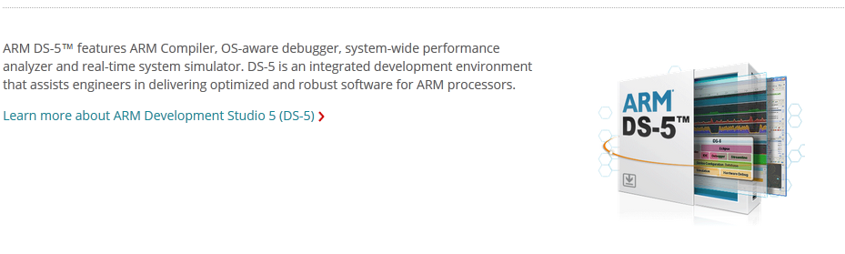
Development Tools http://www.ti.com/lsds/ti/arm/sitara_arm_cortex_a_processor/arm_cortex_a9_core/am437x_arm_cortex_a9/tools_software.page#tools

Slide 57
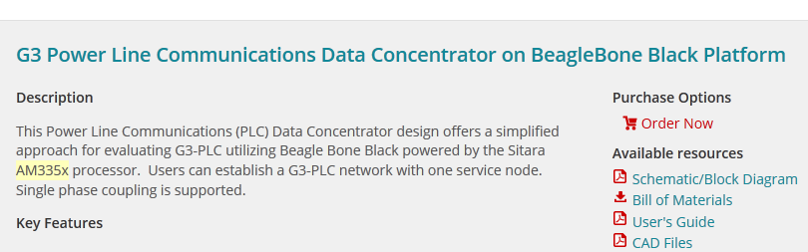
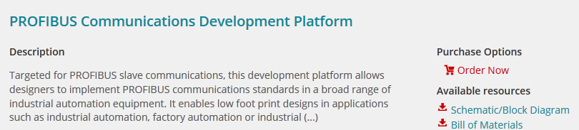
TI Reference Designs http://www.ti.com/general/docs/refdesignsearchresults.tsp?keyword=am335x

Slide 58
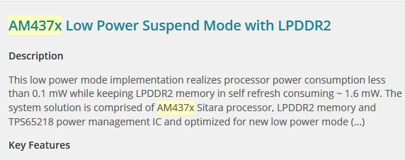
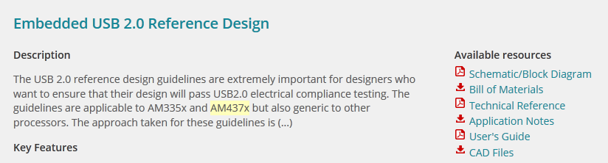
TI Reference Designs http://www.ti.com/general/docs/refdesignsearchresults.tsp?keyword=am437x

Slide 59
Tools and Software: Linux SDK
Sitara Device Overview

Slide 60
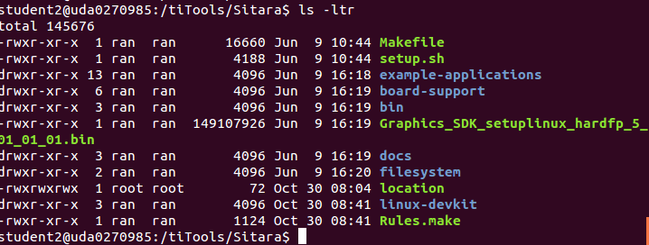
Linux SDK
Notes:
PMU – Programming Multi-channel Unit (The ARM module)
LPDDR - Low Power Double Data Rate memory 266MHZ
DDR3 – 400MHZ
DDR3L – low voltage DDR3
OCMC – On chip memory controller

Slide 61
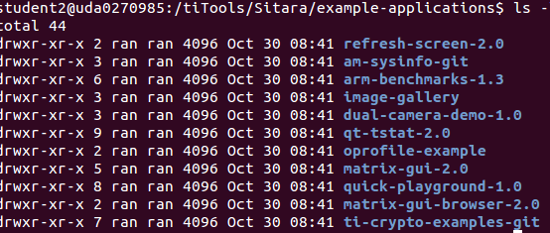
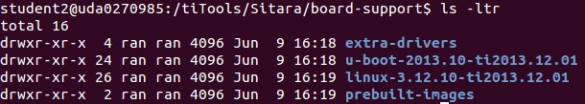
Linux SDK Directories (1)
Notes:
PMU – Programming Multi-channel Unit (The ARM module)
LPDDR - Low Power Double Data Rate memory 266MHZ
DDR3 – 400MHZ
DDR3L – low voltage DDR3
OCMC – On chip memory controller

Slide 62
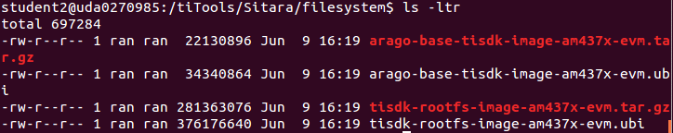
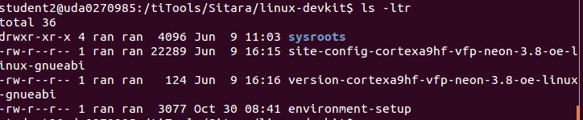
Linux SDK Directories (2)
Notes:
PMU – Programming Multi-channel Unit (The ARM module)
LPDDR - Low Power Double Data Rate memory 266MHZ
DDR3 – 400MHZ
DDR3L – low voltage DDR3
OCMC – On chip memory controller

Slide 63
Tools and Software: Development Platforms
Sitara Device Overview

Slide 64
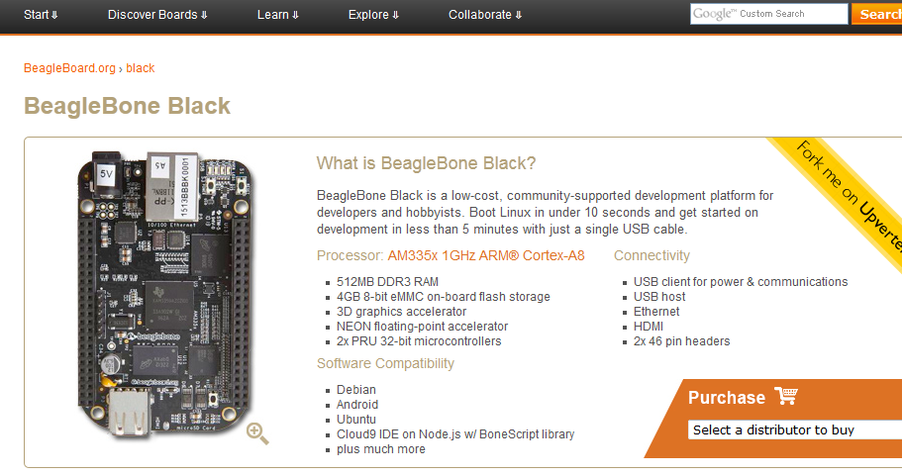
AM335x Development Platforms

Slide 65
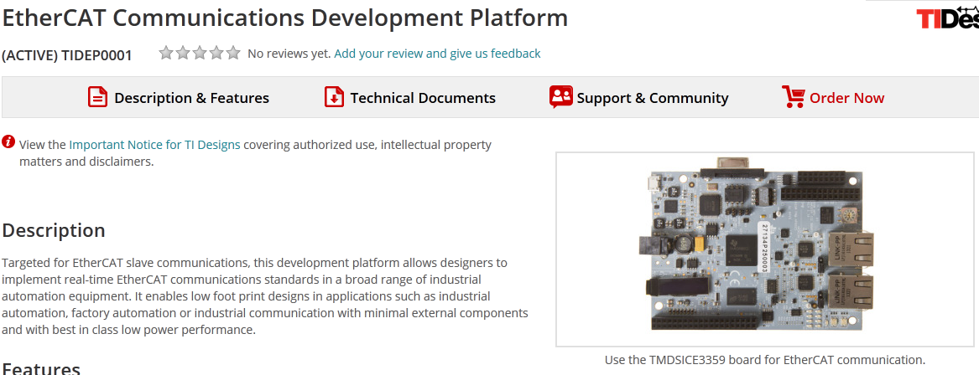
AM335x Development Platforms

Slide 66
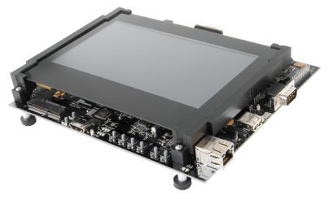
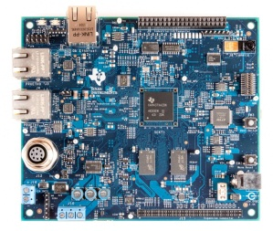
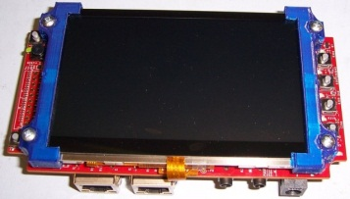
AM437x EVMs and Development Tools
TMDXEVM437X
TMDXSK437X
TMDXIDK437X
CPU-Freq
AM4378 – Up to 1GHz
AM4378 – Up to 1GHz
AM4379 – Up to 1GHz
Memory
2GB DDR3
1GB DDR3L
1GB DDR3
Display
7” Cap Touch / LCD
4.3” Cap Touch / LCD
None
PMIC
TPS65218
TPS65218
Discrete solution
WLAN/BT
Connector for WiLink8
Connector for WiLink8
N/A
Key Features
2x Camera modules
1x Gb Ethernet port
NAND/eMMC
2x DCAN
HDMI/LCD
In/Out audio
1x Camera module
2x Gb Ethernet ports
QSPI-NOR Flash
No DCAN
LCD only
In/Out audio
1x Camera module
QSPI-NOR Flash
1x Gb Ethernet
PWM & ADC
No display
2x Industrial Ethernet
Software
Linux
Linux
SYS/BIOS
Available
2Q 2014
4Q 2014
3Q 2014
Target: $599
Target: $299
Target: $329

Slide 67
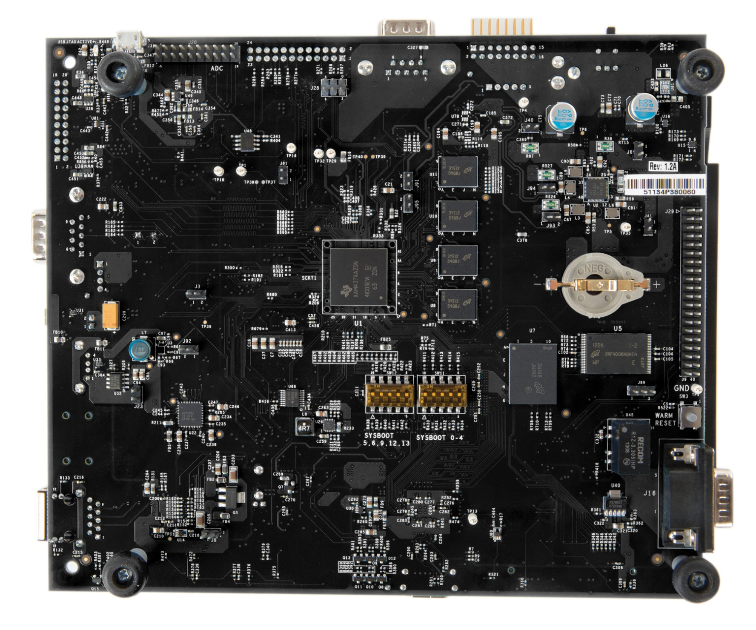
Peripheral Support on AM437x GP EVM
USB JTAG
ADC header
4 x8 Fly-by DDR3
uSD
PMIC
AM437x
NAND (4Gb)
Audio codec
SYSBOOT
eMMC (4GB)
DCAN #1

Slide 68
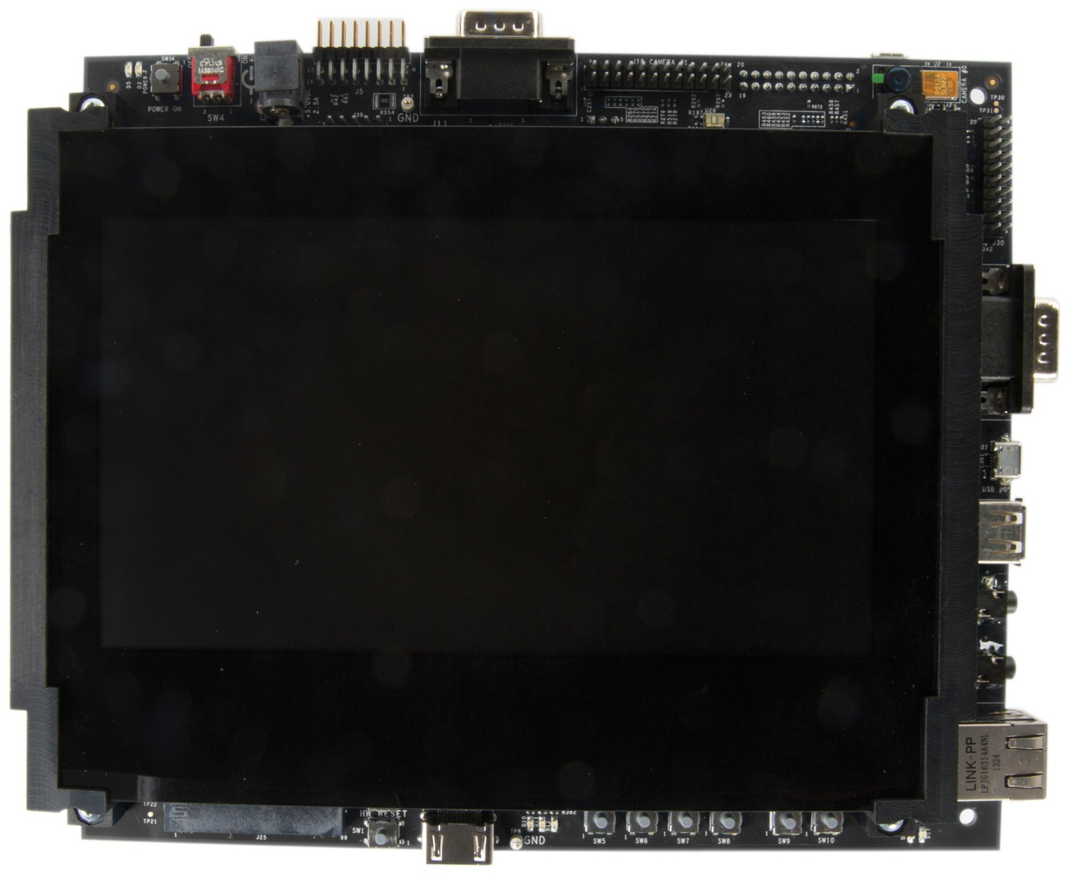
Power switch
DCAN #0
Camera #1
connector
+5V
Camera 2Mp
Power LEDs
20-pin ARM
JTAG Connector
UART #0
7” LCD
800x480
Touchscreen
Micro USB 2.0
USB 2.0
Audio in
Audio out
Gigabit
Ethernet
WLAN/BT COM
connector
User LEDs
User Buttons
HDMI

Slide 69
For More Information
Sitara Processors Product Overview: http://www.ti.com/lsds/ti/arm/sitara_arm_cortex_a_processor/overview.page
Sitara Processors Wiki: http://processors.wiki.ti.com/index.php/Sitara
For questions regarding topics covered in this training, visit the support forums at the TI E2E Community website.

